Slide 1

ISO 9001:2000 Protocol of Standards - Maybe the way in lighting our next step and/or the dream route to excellence
Ivan Mencer
Faculty of Economics
University of Rijeka
Dubrovnik, October 11, 2003

Slide 2
In general, our Mission is:
To teach and create new knowledge in each specific field of interest!

Slide 3
So, the vision could be: the continuos improvement of our processes!

Slide 4
If so, there is just one way of playing the game: evolution, not revolution!

Slide 5
How to follow this way, and what method should be used?
First answer could be:
Adapt, not adopt! (?)
Following first possible answer, the second answer is:
Benchmarking!
Benchmarking is the process of identifying, understanding, and adapting outstanding practices and processes from organizations to improve its performance. [John Macdonald, The quality revolution in retrospect, The TQM Magazine, Volume 10-Number 5. MCB University Press, 1998, pp. 321-333 ]

Slide 6
How to adapt? How to catch the experience of the best, or just to try following them? How to use our gathered experience , corporate culture, or shared values and system of thinking on Croatian universities?
World industry practices offer some solutions, such as quality protocols that are based on thoughts and experiences of the best companies in world such as General Motors, Ford, 3M, Motorola, IBM, DuPont, General Electric, Eastman Kodak, British Telecom and Philips Electronic.

Slide 7
Some possibilities are:
1) ISO protocol of standards
2) Malcolm Baldrige National Quality Award
3) European Quality Award
4) Six Sigma
5) Deming (14), or Ishikawa(11), Feigenbaum (19), Crosby’s (14) set of points
5) Other Oscars such as Deming’s Price in Japan.

Slide 8
Please, remember!
In our case, these protocols could be used, but not for marketing purposes.
The principal motivation is to concentrate on using our experience and experience of the others universities on the way to reach never ending story - the excellence of our processes.

Slide 9
Why?
The answers are simple!
(1) to satisfy the objects of Bologna’s process and
(2) to follow the way on route to excellence. It means, not to be the best in comparison to the others. Just to be better, and better in addition to ourselves.

Slide 10
What to suggest? Which approach is the best?
Maybe ISO’s approach! (?)
Why?
Because, the ISO as a platform for quality management, is:
(1) the oldest international system of standards,
(2) in average, the most popular in the world, and
(3) the best known and mostly used in Croatian industry.

Slide 11
Little history of a Quality Management Standards
The modern thought about quality was becoming in the period between two world wars, in the year 1931, when W.S. Shewhart of Bell Laboratories published his “Economic Control of Quality of Manufacture Product”.
1) In 1959, U.S. department of defense developed MIL-Q-9858, which was a system for quality management.
2) These system was revised in 1963.
3) In 1968 it was adopted by NATO as its Allied Quality Assurance Publication 1 (AQAP-1).
4) In 1970 AQAP-1 was adopted by the United Kingdom Ministry of Defence.

Slide 12
5) In 1979 the British Standards Institute establish BS 5750, which addressed the organization and documentation necessary to produce consistent quality.
6) In 1980 was formed Committee on Quality by International Organization for Standardization in Geneva.
7) In 1987, 91 member nations of ISO published a series of five quality assurance standards (ISO 9001, 9002, 9003 and 9004). The series ware based on BS 5750.

Slide 13
8) In 1987 was establish another system of quality in U.S, the Malcolm Baldrige National Quality Award. In 2001, for the first time, Malcolm Award was given to an university - University of Wisconsin - Stout (Menomonie)
9) Six Sigma was establish by Motorola in the year 1987
10) In 1994 ISO 9000 from 1984 was revised.

Slide 14
11) In 2000 ISO, as the result of continuos improvement, implement new approach, strictly based on eight management principles, as follows:
11.1. Customer focus
11.2. Leadership
11.3. Involvement of people
11.4. Process approach
11.5. System approach to management
11.6. Continual improvement
11.7. Factual approach to decision making
11.8. Mutually benefit supplier relationship

Slide 15
What is quality?
Quality was used over the years to describe attributes such as beauty, goodness, expensiveness, freshness and above all luxury.
Quality is:
1. Any of the features that make something what it is characteristic, element, attribute
2. Basic nature, character, kind
3. The degree of excellence which a thing possesses
4. Excellence, superiority
5. Position, capacity, role…
[Webster’s New World College Dictionary, Macmillan, 1996, New York, USA, p.1099]

Slide 16
ISO 8042:1994. definition of quality is:
The totality of characteristics of an entity that bear on its ability to satisfy stated and implied needs.
ISO 9000:2000 defines quality as:
The degree to which a set of inherent characteristics fulfils requirements.
It needs to be added that the same standard defines the product as a result of a process.
Still one warning! It is extremely important to differ the term quality and grade.

Slide 17
Quality is meeting the needs and expectation of the customer.
Practically, quality is the gap between how good something is and how good it possibly could be, and that we should continually focus on narrowing that gap.
[Lynda King Taylor, Quality:Total Customer Service, The Sunday Times Business Skills, London 1992, p.140]

Slide 18
Quality is a result of continual fight to overcome our weaknesses.

Slide 19
So, when we mention the term quality, our expression could be understood as (1) a matter of individual perception (taste) and (2) the system of all characteristics (elements) of an entity.

Slide 20
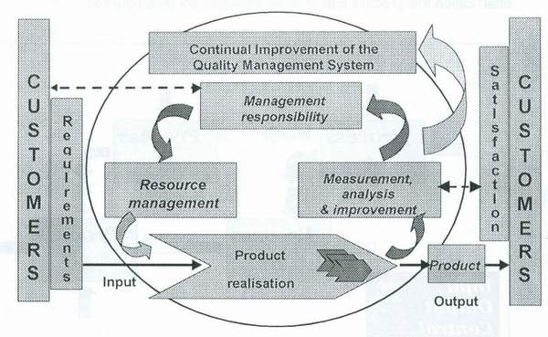
Some basic information about ISO 9001:2000
Figure 1 Conceptual presentation of QMS model

Slide 21
The structure of ISO 9001:2000 is, as follows:
4 Quality Management System
4.1 General requirements
4.2 Quality manual
4.2.3 Control of documents (obligatory requirement)
4.2.4 Control of records (obligatory requirement)
(continue)

Slide 22
5 Management responsibility
5.1 Management commitment
5.2 Customer focus
5.3 Quality policy
5.4 Planning
5.4.1 Quality objectives
5.4.2. Quality management system planning
5.5 Responsibility and authority
5.5.2 Management representative
5.5.3 Internal communication
5.6 Management review
5.6.1 General
5.6.2 Review input
5.6.3 Review output
(continue)

Slide 23
6 Resources management
6.1 Provision of resources
6.2 Human resources
6.2.1 General
6.2.2 Competence, awareness and training
6.3 Infrastructure
6.4 Work environment
(continue)

Slide 24
7 Product realization
7.1 Planning of realization processes
7.2. Customer related processes
7.2.1 Determination of requirement related to the product
7.2.2 Review of requirements related to the product
7.2.3 Customer communication
7.3.Design and development planning
7.3.1 Design and development planning
7.3.2 Design and development inputs
7.3.3 Design and development outputs
7.3.4 Design and development review
7.3.5 Design and development verification
7.3.6 Design and development validation
7.3.7 Control of design and development changes
(continue)

Slide 25
7.4 Purchasing
7.4.1 Purchasing process
7.4.2 Purchasing information
7.4.3 Verification of purchased product
7.5 Production and service provision
7.5.1 Control of production and service provision
7.5.2 Validation of processes for production and service provision
7.5.3 Identification and traceability
7.5.4 Customer property
7.5.5 Preservation of product
7.6 Control of monitoring and measuring devices

Slide 26
8 Measurement, analysis and improvement
8.1 General
8.2 Monitoring and measurement
8.2.1 Customer satisfaction
8.2.2 Internal audit (obligatory requirement )
8.2.3 Monitoring and measurement of processes
8.2.4 Monitoring and measurement of product
8.3 Control of non conforming product(obligatory requirement) 8.4 Analysis of data
8.5. Improvement
8.5.1 Continual improvement
8.5.2 Corrective action (obligatory requirement )
8.5.3 Prevention action (obligatory requirement )

Slide 27
Malcolm Baldrige National Quality Award is consisted on seven core categories. Each category gathered some items with point values.
The structure is, as follows:
1. Leadership (95 point values)
2. Information and analysis (75 point values)
3. Strategic Quality Planning (60 point values)
4. Human Resource Development and Management (150 point values)
5. Management and Process of Quality (140 point values)
6. Quality and Operational Results (180 point values)
7. Customer Focus and Satisfaction (300 point values)
All together point values 1000

Slide 28
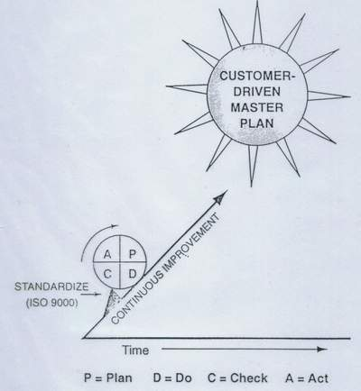
Nevertheless, ISO standards are maybe closer to us than Malcolm’s approach.
Figura 2 The potential role and real position of ISO in TQM continual improvement processes

Slide 29
Whether we accept the potential strength of ISO 9001:2000 model for implementing a specific framework for reaching a constant quality level, which assures a continual improvement process, it is quite reasonable to propose some details, such as:
1 Top management must take charge of quality management implementation and their unconditional commitment to quality constitutes the cornerstone of the system.
2 Personnel throughout the organization must be exposed to training in quality management.
3 Quality improvement must be viewed as a continuos process.
4 Participation of the work force in quality improvements must be secured.

Slide 30
For us, ISO protocol of standards, or any other system of quality management do not have to be a platform of being involved in the award process. We, in academic community, do not need to get a formal award.
ISO could be the way, because
ISO set of quality standards, as the result of outstanding experience from the West, guarantees faster way to achieve quality goals than wasting time to find our own framework of quality.
The problem is not to adapt to western experience, but to put together our own experience in a consistent framework of quality.
In Croatia there are some good examples:
Faculty of Maritime Studies University of Rijeka.

Slide 31
This Faculty has been pressed to implement the ISO 9001:2000, under the STCW convention prepared by IMO, London 1978 and 1995. www.pfri.hr

Slide 32
It also must be mentioned that some firms in Rijeka that have an ISO 9001:2000 and 14001:1995 certifications are in big business problems, thanks to non clever strategic decisions.
The certifications can not help to overcome these problems. The ISO framework can exclusively help if top management decisions are not mindless.

Slide 33
If we follow suggestions of an expert who is passionate for quality, ideal quality system could be:
1. Quality-centric focus on continual improvement using Six Sigma in all areas of the company - not just the manufacturing department.
2. ISO 9001:2000 provides good model on how to structure a quality system.
3. ISO 9001:2000 approach on documentation system using the same structure.
4. The Baldrige criteria as an auditing tool for those who want to identify areas of strength and area for improvement.
[Scott Dalgleish, My Ideal Quality System, Quality, Bensenvillle, IL, July 2003, p 14]

